Slide 1
The Layers of the Earth!

Slide 2
Earth Layers
The Earth is divided into four main layers.
*Inner Core
*Outer Core
*Mantle
*Crust

Slide 3
The Crust
* The Earth’s crust is like the skin of an apple.
*The crust makes up 1% of the Earth.
*Solid, rocky,
Contains both oceanic crust and continental.
Top part of the lithospheric plates.

Slide 4
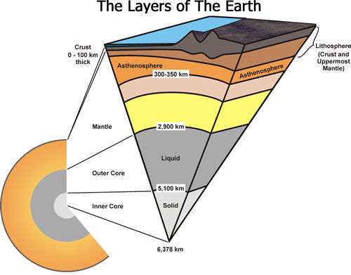
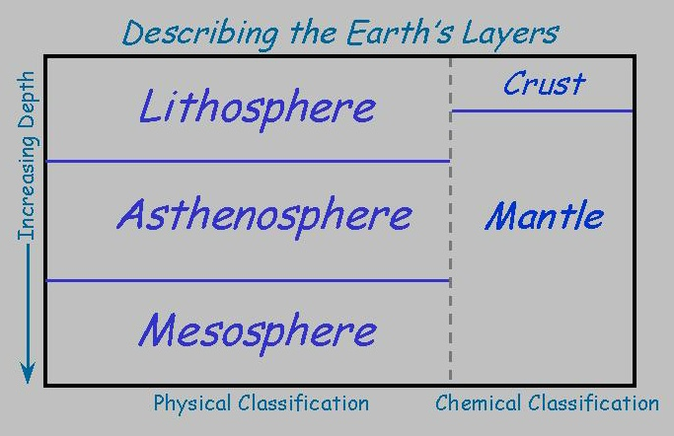
The Mantle
layer below the crust.
largest layer.
divided into two regions: the upper and lower sections

Slide 5
The Mantle
The upper mantle is solid
Part of lithospheric plates
The lower mantle is liquid and plastic-like and is called the asthenosphere.
made of mostly the rock Periodite,
650 km thick
greater than 1300 degrees Celsius.

Slide 6
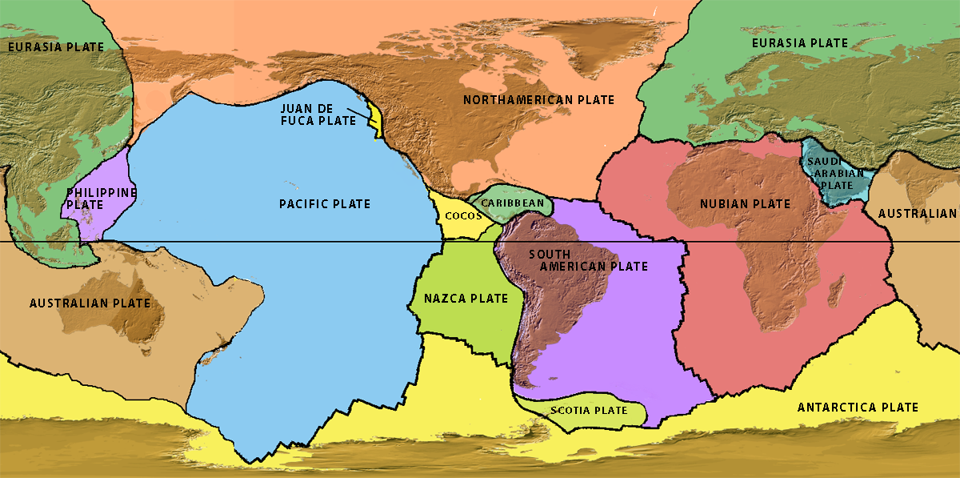
There are a dozen large lithospheric plates (smaller plates not shown). Some plates have continents; some don’t. All are in motion.
Lithospheric Plates
Flash Rollovers
“Tectonic Plates” & “Plates, Earthquakes, and Volcanoes”
Notes:
Any map of plates shows that there are about a dozen large plates and a number of smaller plates. The smallest plates are not included here. Remember that “Plate Tectonics” is a fairly new scientific discovery stimulated by exploration of the ocean basins after WWII. In 1950, most people didn’t believe that the continents could move across Earth’s surface. This simple map does not show broad areas of deformation between plates. We will see that in a later slide.
ANIMATIONS: This and the next few slides are available on the Teachers on the Leading Edge web site as FLASH rollovers under “Animations” under the topic “Introduction to Plate Tectonics and Earthquakes”.
URL TectonicPlates http://multimedia2.up.edu/Physics/TOLE/Plates&Earthquakes/Animations/FLASHRollovers/TectonicPlates.swf
URL Plates, Earthquakes, and Volcanoes http://multimedia2.up.edu/Physics/TOLE/Plates&Earthquakes/Animations/FLASHRollovers/DynamicPlanet.swf

Slide 7
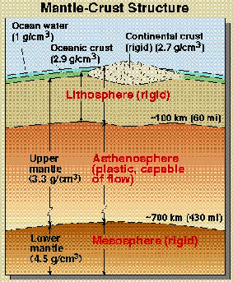
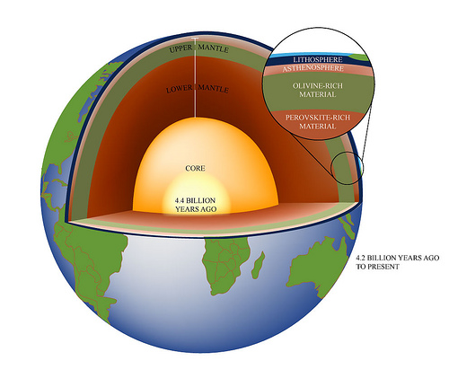
What are Plates made of?
1. Lithosphere plates – the crust and upper part of the mantle

Slide 8
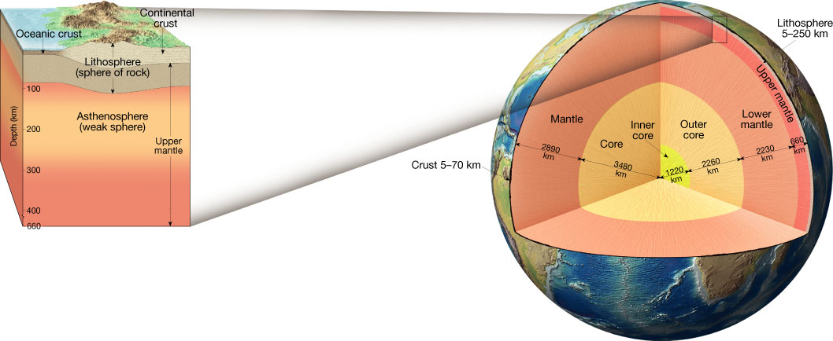
Asthenosphere/lithosphere

Slide 9
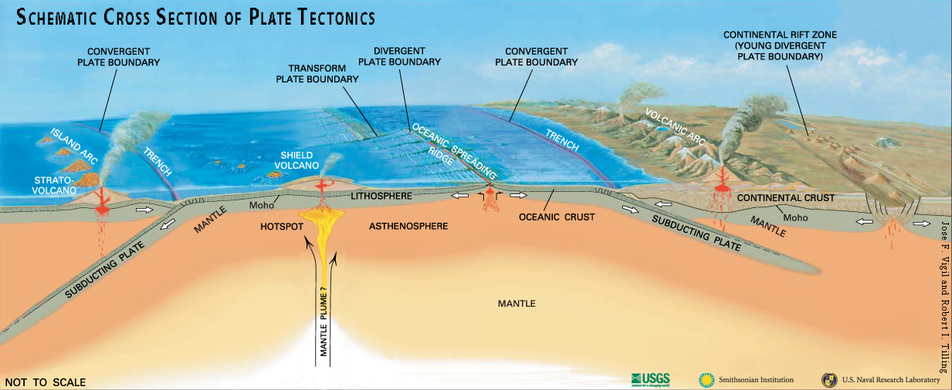
What are the tectonic plates?
Lithosphere
Is the ~100-km-thick surface of Earth;
Contains crust and upper mantle;
Is rigid and brittle;
Fractures to produce earthquakes.
Watch video lecture
“Lithospheric plates”
Notes:
There is widespread confusion between “crust” and “plates”. Unfortunately this confusion is reinforced by many popular science programs [e.g. Discovery Channel programs, etc.]). It’s not complicated if you lay this out correctly from day #1. The “plates” of plate tectonics are more correctly referred to as “lithospheric plates”. The upper portion of the lithospheric plates is Earth’s crust that is the outer rock layer of Earth chemically distinct from the underlying mantle layer. The deeper portion of the lithospheric plates is mantle material. To distinguish mantle rocks that are part of lithospheric plates from deeper, hotter, and therefore weaker mantle rocks, the term “lithospheric mantle” is sometimes used for the mantle that makes up the deeper part of plates. Total thickness of lithospheric plates is about 100 km. Compared to deeper layers of Earth, lithospheric plates are colder, more rigid, and much more brittle (capable of breaking when large forces are applied). The mantle below the plates is called “asthenosphere” or “asthenospheric mantle”. This part of the mantle is not liquid but it is close to its melting temperature. It is therefore capable of flowing (at very slow rates) if forces are applied for long times. Silly putty is a useful analog to the mechanical behavior of the asthenosphere.
VIDEO LECTURE: “Lithospheric Plates” on Teachers on the Leading Edge web site under “Videos” under the topic “Introduction to Plate Tectonics and Earthquakes”. URL for Lithospheric Plates http://multimedia2.up.edu/Physics/TOLE/Plates&Earthquakes/VideoLectures/TectonicPlates.mov
Background graphic from “This Dynamic Planet, World Map of Volcanoes, Earthquakes, Impact Craters, and Plate Tectonics.” A Smithsonian, USGS, US Naval Research lab publication. Available at http://mineralsciences.si.edu/tdpmap/ (Note that this material is copyright protected; the content may only be used for personal, educational or noncommercial purposes.)

Slide 10
Plates are made of both Oceanic and Continental Crust
Continental Crust
Oceanic Crust
Less dense (lighter)
2.7 g/cm
Made of mostly silicate/granitic rocks
Older (4bya)
More dense(heavier)
2.9 g/cm
Made of mostly heavier basaltic rocks
Younger (180myo)

Slide 11
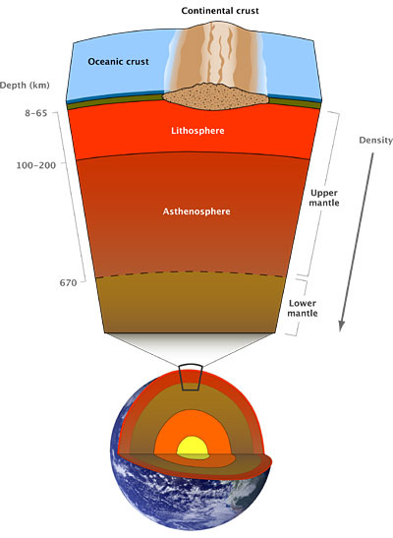
Lower section of mantle
Rocks are very hot and capable of gradual flow
More rigid layer
Not part of the plates or asthenosphere.

Slide 12
Outer Core
The outer core is liquid
Greater than 4500’ Celsius
made up of iron and nickel.
Very dense (11g/m)
It is 1400- 2200 km thick

Slide 13
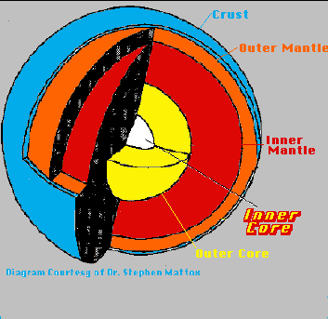
Inner Core
Pressures very high, so solid.
Temp is greater than 5000’Celsius
1250 km thick
Iron and Nickel

Slide 14
Review
1) What are the four layers of the Earth?
2) The Earth’s crust is very ______?
3) The mantle is the largest layer of the Earth? True or False
4) Is the Outer Core a liquid or a solid?
5) Is Continental or Oceanic Crust denser?
6) What two parts of the earth make up the lithosphere?

Slide 15
Answers!
1) Crust, Mantle, Outer Core, Inner Core
2) Thin
3) True
4) Liquid
5) Oceanic is denser
6) Crust and top part of the mantle.

